Slide 1
IMPLEMENTATION OF PLANT DISEASE IDENTIFICATION USING ADVANCED DEEP LEARNING

Slide 2
INTRODUCTION
Challenge: Plant diseases significantly impact crop health, yield, and food security.
Complexity: Accurate disease identification is difficult due to diverse pathogens and symptoms.
Objective: Improve diagnostic methods and accuracy for plant disease identification.
Approach:
Enhance current identification techniques.
Develop a comprehensive database linking symptoms to pathogens.
Provide practical resources and knowledge for better disease management.
Goal: Support sustainable farming, reduce economic losses, and improve overall agricultural practices.

Slide 3
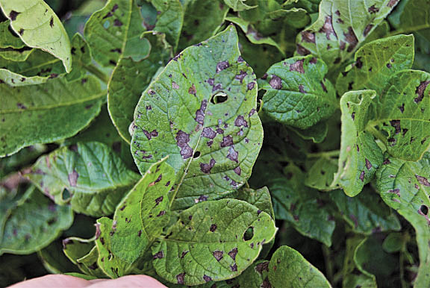
DISEASE IDENTIFICATION
The different types of potato plant diseases are as follows :-
Early Blight:
Cause: Fungal pathogen Alternaria solani.
Conditions: Prefers warm, dry conditions and can spread through infected plant debris, seeds, and soil.
Symptoms: Dark, concentric ring lesions on leaves; can also affect stems and tubers.
Impact: Reduces yield and quality; prefers warm, dry conditions.

Slide 4
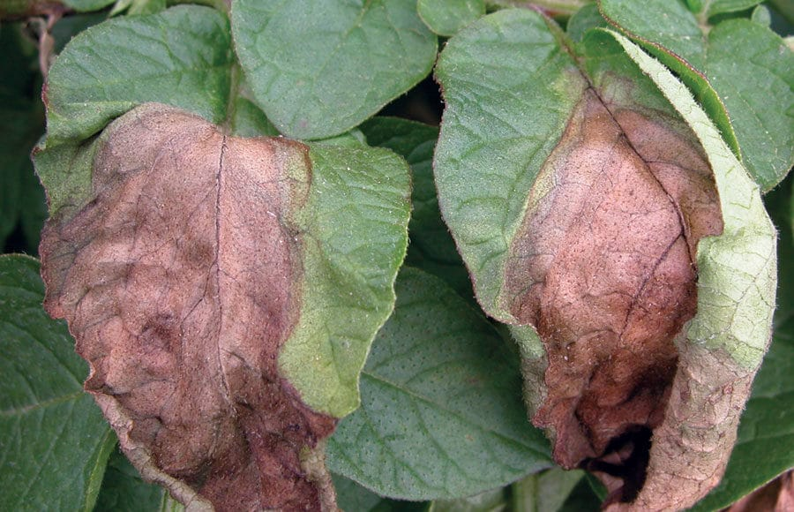
2. Late Blight:
Cause: Oomycete pathogen Phytophthora infestans.
Conditions: Thrives in cool, wet conditions with high humidity; spread rapidly under favorable weather conditions.
Symptoms: Dark, water-soaked lesions on leaves, stems, and tubers; white mold on the underside of leaves.
Impact: Can cause severe crop loss; thrives in wet conditions.

Slide 5
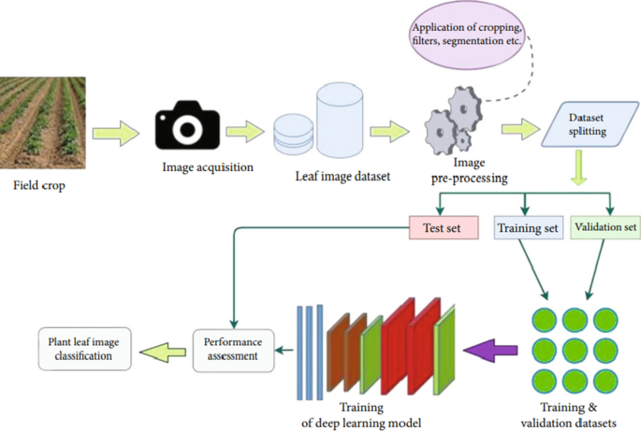
FLOWCHART

Slide 6
DATA COLLECTION AND PREPROCESSING
Data Collection :
Image Acquisition: Collect images of plants with and without diseases. These images can be obtained from public datasets, field surveys, or lab-controlled environments.
Sources:
TensorFlow dataset
Existing Kaggle dataset
Online images on Google scraped via a web scraping bot
2. Data Preprocessing :
Data Augmentation: Techniques like rotation, flipping, scaling, and color adjustments are applied to increase the diversity of the dataset and improve model generalization.

Slide 7
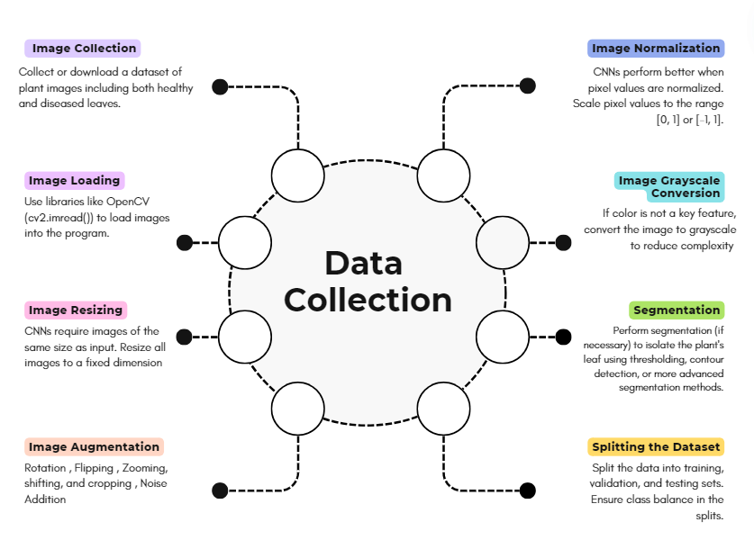

Slide 8
MODEL SELECTION
We have chosen Convolutional Neural Networks (CNN) for Plant Disease Identification
Why CNNs?
Specialization in Image Data: CNNs are designed to process and analyze visual data, making them highly effective for tasks involving images. They excel at detecting and interpreting spatial hierarchies and patterns within images.
Visual Features: Plant disease identification relies on visual characteristics such as color, texture, and shape of leaves. CNNs can automatically learn these features, which are crucial for accurate disease classification.
Advantages of CNNs:
Automated Feature Extraction: Reduces manual feature engineering by learning relevant features from images.
Complex Pattern Recognition: Handles large-scale datasets and complex visual patterns effectively.

Slide 9
PARAMETERS :
Activation Functions
ReLU: Used in convolutional layers to introduce non-linearity.
Softmax: Applied in the final layer to convert outputs into probabilities for multi-class classification.
Loss Function
Categorical Crossentropy: Appropriate for multi-class classification tasks like identifying multiple plant diseases.
3. Optimizer
Adam Optimizer: Selected for its adaptive learning rate and efficiency in handling sparse gradients and noisy data.
Evaluation Metrics
Accuracy: Measures overall classification performance.
Precision: Evaluates the model's ability to correctly identify diseased versus healthy plants, especially important for imbalanced datasets.

Slide 10
WEB AND APP INTEGRATION
API Development: Create APIs to enable communication between the model and web/app interfaces.
Frontend Integration: Embed model functionalities into web or app interfaces for user interaction.
Backend Integration: Host the model on a server and ensure it can handle requests from web/app clients.
Data Handling: Implement data input and output processes for user submissions and model predictions.
User Interface: Design intuitive interfaces for users to interact with the model and view results.

Slide 11
ADVANTAGES AND APPLICATIONS
Enhanced Disease Detection: Improves accuracy in identifying plant diseases.
Faster Diagnosis: Automated analysis speeds up disease detection and response.
Reduced Crop Loss: Early identification helps minimize crop damage and losses.
Support for Farmers: Provides valuable tools and insights for effective disease management.
Scalable Solution: Can be adapted to various crops and expanded with more data and features.

Slide 12
REFERENCES
https://epubs.icar.org.in/ejournal/index.php/IJAgS/article/download/98996/39374
https://www.researchgate.net/profile/Saif-Katper/publication/341025012_Plant_Disease_Detection_using_Deep_Learning/links/5eabf714299bf18b958a94a8/Plant-Disease-Detection-using-Deep-Learning.pdf
https://openai.com/research/
https://vegpath.plantpath.wisc.edu/diseases/potato-early-blight/
https://www.legacyias.com/about-the-late-blight-disease/

